Slide 1
Module 4: Describing Chemical and Physical Changes
Balancing and Interpreting
Chemical Equations
Fundamentals of Chemistry Open Course

Slide 2
Learning Objectives | Module 4
Distinguish between chemical and physical changes, particularly in equations containing chemical formulas.
Interpret chemical equations to visualize chemical reactions or physical changes.
Determine whether a given chemical equation is balanced or not; balance chemical equations.
Apply chemical equations to determine the outcome of a chemical reaction on the submicroscopic level.
Convert a submicroscopic image of a chemical reaction or physical change into a chemical equation.

Slide 3
Conservation of Mass in Chemical Equations
Valid chemical equations are balanced. From the law of conservation of mass, it follows that in a physically valid chemical equation, the numbers of each type of atom must be equal on the reactant and product sides.
To find the number of atoms of an element in a substance in an equation, we multiply the subscript(s) on that element by the stoichiometric coefficient of the substance.
Example. Tin(IV) chloride reacts with sulfuric acid to yield tin(IV) sulfate and hydrochloric acid. A balanced chemical equation for this process is shown below. Show that the equation is balanced.
SnCl₄ + 2 H₂SO₄ → Sn(SO₄)₂ + 4 HCl

Slide 4
Balancing Chemical Equations | 1 of 2
If chemical formulas of the reactants and products are known, we can balance a chemical equation by adjusting
the stoichiometric coefficients to equalize the atoms on both sides of the equation.
Decimal or fractional coefficients are completely fine in chemical equations!
Balancing can be done by inspection by focusing on elements that appear in only one substance
on each side of the equation.
Example. Balance the following chemical equation by inspection.
Rb + RbNO₃ → Rb₂O + N₂

Slide 5
Balancing Chemical Equations | 2 of 2
Balancing can also be done systematically using a system of equations or matrix algebra.
NOT recommended unless the equation is extremely complicated!
An equation is set up for each element that has the form [atoms on the left] = [atoms on the right].
One of the coefficients can be assumed equal to 1. Remember that if desired,
all coefficients can be scaled at the end.
Example. Balance the following chemical equation using a system of equations.
x₁ Rb + x₂ RbNO₃ → x₃ Rb₂O + 1 N₂

Slide 6
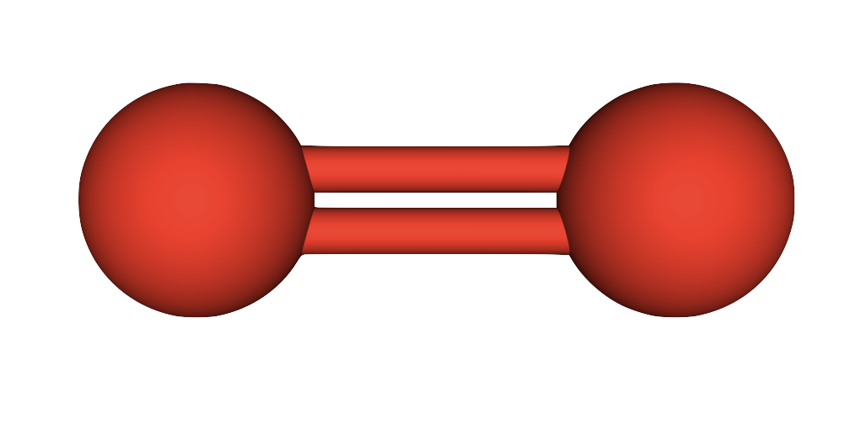
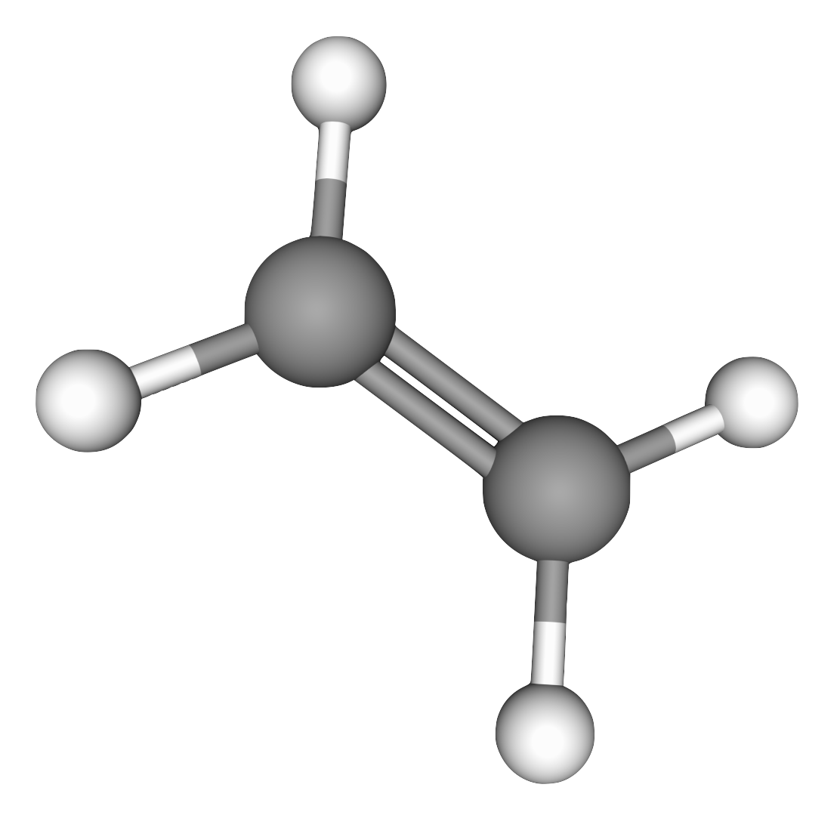
Submicroscopic Models of Chemical Reactions
When molecules combine in chemical reactions, atoms are conserved. Each reaction event takes place
in accordance with the balanced chemical equation.
Using a balanced equation and numbers of reactant molecules, we can work out
the composition of a reaction mixture at the end of the reaction.
Example. Ethylene (C₂H₄) reacts with oxygen (O₂) according to the balanced chemical equation below. What is the composition of the reaction mixture at the end of the reaction, given the numbers of molecules in the image?
C₂H₄(g) + 3 O₂(g) → 2 CO₂(g) + 2 H₂O(g)

Slide 7
Lingering Questions
How do we make use of balanced chemical equations to plan and carry out chemical reactions?
How do we determine experimentally the chemical formulas of reactants and products
and the number ratios in which they combine?

